Slide 1
Data Science Analysis with Python
Note to other teachers and users of these slides. Feel free to use or modify these slides as you wish. If you use a significant portion of these slides in your own lecture, please include this message, or the following link to the source repository of Michele’s lectures on github:
https://github.com/samorani. Comments and corrections are welcome.
Set up
Python Review
`

Slide 2
About me
Michele Samorani
“Michele” is pronounced MEE-KEL-LAY
Assistant Professor
B.Eng and M.Eng in Computer Science from University of Bologna
Ph.D in Operations Management and Information Systems from University of Colorado
Main research area:
Data Mining to improve healthcare operations

Slide 3
Outline
Download and install Canopy
Introduction to this course
Python review

Slide 4
Data Science
“An interdisciplinary field about scientific processes and systems to extract knowledge or insights from data in various forms, either structured or unstructured” (from Wikipedia)
Interdisciplinary:
Statistics
Math
Operations Research
Databases
Machine learning
Artificial intelligence
…
Data:
Structured (relational database, social network)
Unstructured (text, video, audio)

Slide 5
Two flavors of Data Science
Data Mining: Extract knowledge for decision making through ad-hoc analysis. Examples:
Find interesting patterns in the “welcome survey” results
Analytics: Automatically use predictive techniques for optimal decision making. Examples:
Amazon and Netflix recommends us items we might like
Google and Facebook show us ads that we might be interested in
Return policy on jet.com
We will focus on this

Slide 6
Shortage of data scientists
A McKinsey report finds that ”by 2018, the United States alone could face a shortage of 140,000 to 190,000 people with deep analytical skills as well as 1.5 million managers and analysts with the know-how to use the analysis of big data to make effective decisions.”

Slide 7
This course

Slide 8
Data Science Anaysis with Python
Course objectives
To study some fundamental concepts of Data Science
To learn the Python packages for Data Science
Parts of the course
Part 1: Becoming a data janitor (manipulation, cleaning, aggregating, visualization)
Part 2: Becoming a data scientist (some machine learning techniques)
If you pass the course, add the following items to your résumé
Python: numpy, pandas, seaborn, scikit-learn
Data Science: data wrangling, visualization, classification, regression, clustering
Experience with real-world data

Slide 9
Data Science Anaysis with Python
What we won’t cover
Big data
Statistics

Slide 10
This course
Visualization
Seaborn
scikitlearn
Machine learning package
pandas
Data structures package
numpy
Computation package
Python
Language, syntax

Slide 11
This course*
Visualization
scikitlearn
Machine learning package
Seaborn
pandas
Data structures package
numpy
Computation package
Python
Language, syntax
* The height of the boxes is scaled according to the expected amount of time spent

Slide 12
How this course will feel like
Lots of coding
Hands-on
Practice in and out of class

Slide 13
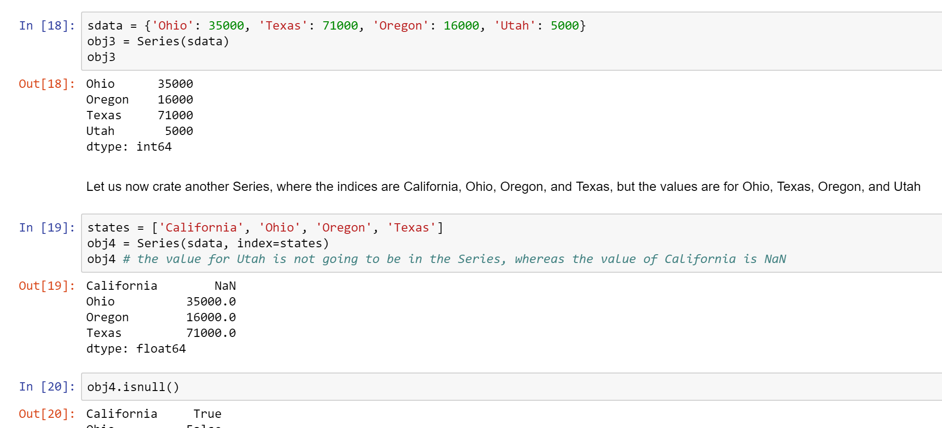
How the course looks like – pandas

Slide 14
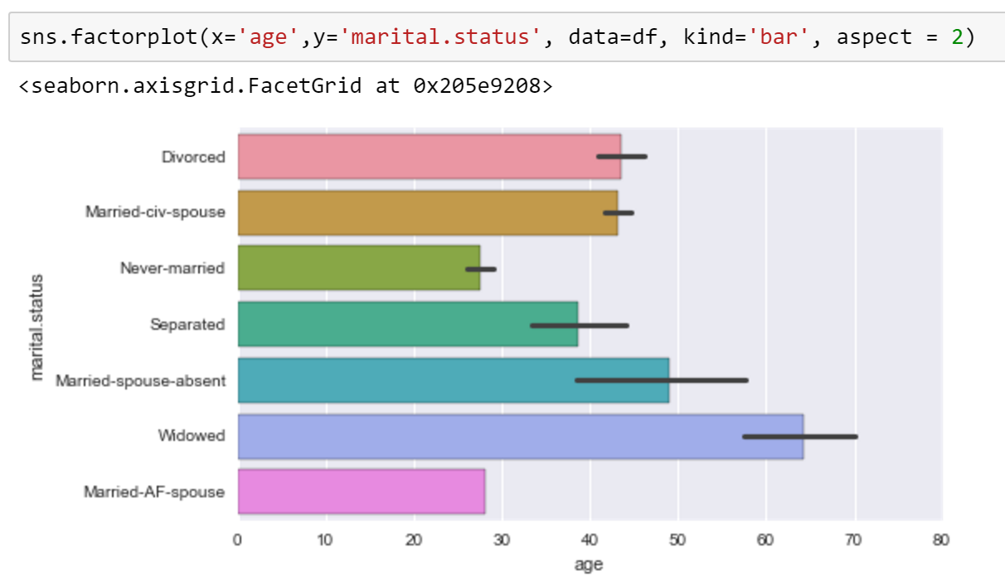
How the course looks like – seaborn

Slide 15
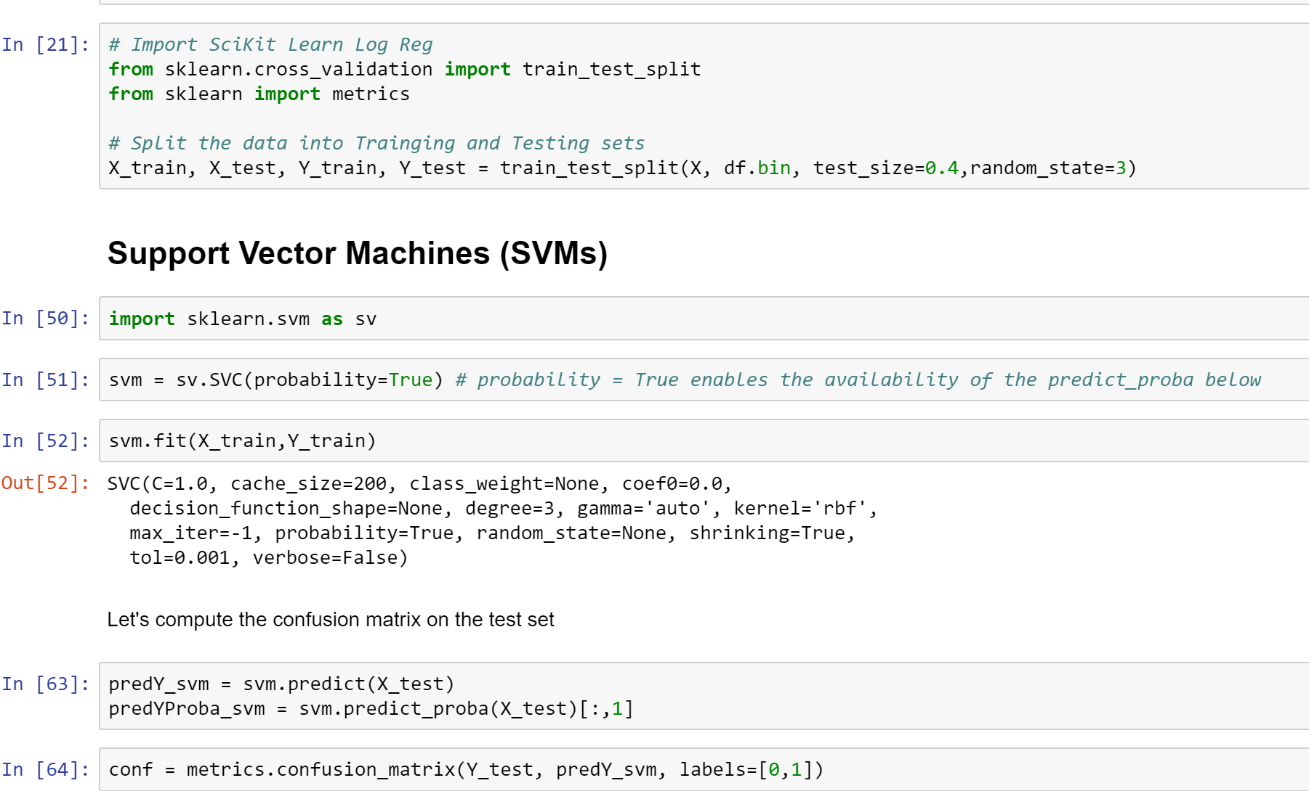
How the course looks like – scikit-learn

Slide 16
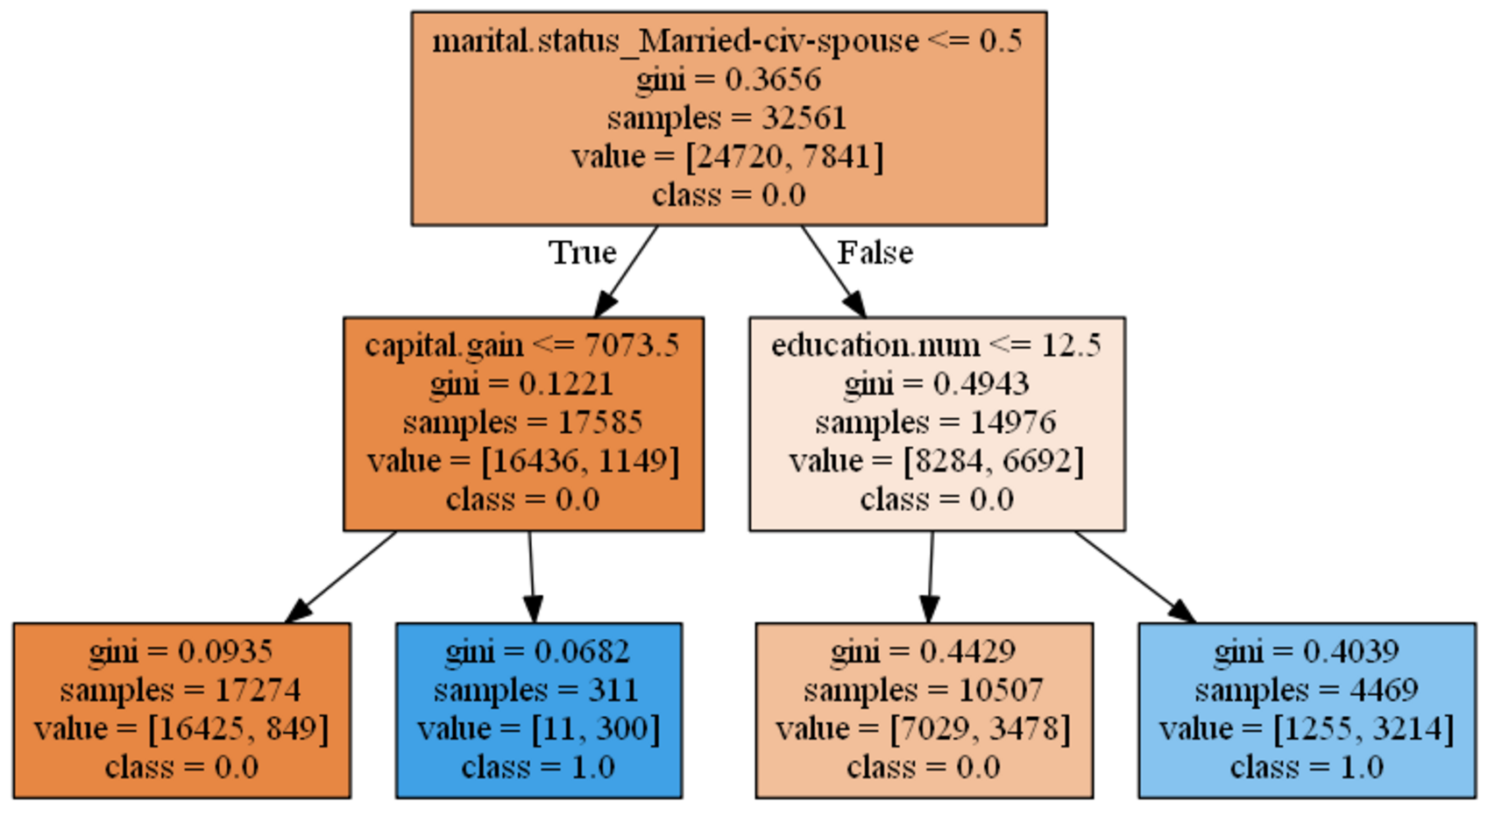
How the course looks like – scikit learn

Slide 17
Evaluation
Online Python Tutorial 10%
Takes many hours
Start early!
Midterm Exam 30%
Some in-class and some take-home
Homework 30%
Individual weekly assignments
Final Group Project and presentation 30%
Groups of exactly two people; at most one group of three people
The last two lectures will be dedicated to project presentations
Presentations are mandatory

Slide 18
Submission for Completing CodeAcademy Assignment
This assignment will represent your completion of the following Python online tutorial:
https://www.codecademy.com/learn/python

Slide 19
Install Canopy

Slide 20
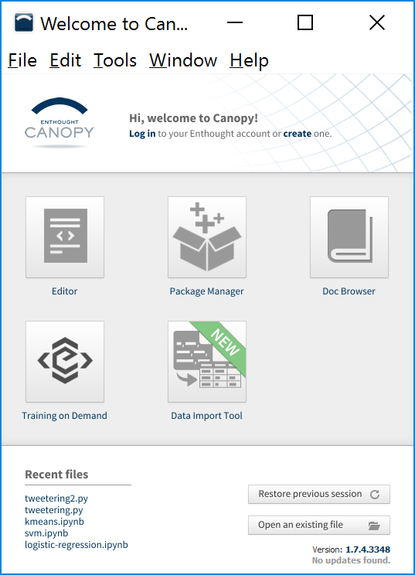
Canopy
To install packages
For example, let us install pandas
To program

Slide 21
Canopy – install pandas
Click here

Slide 22
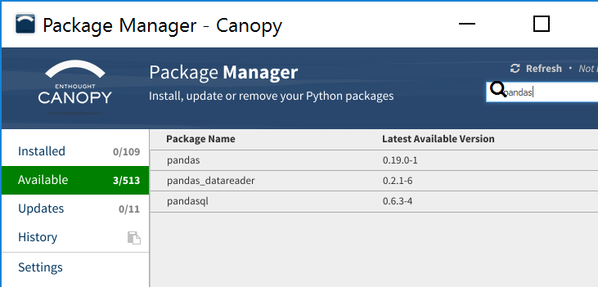
Canopy – install pandas
2) Type pandas
1) Select available

Slide 23
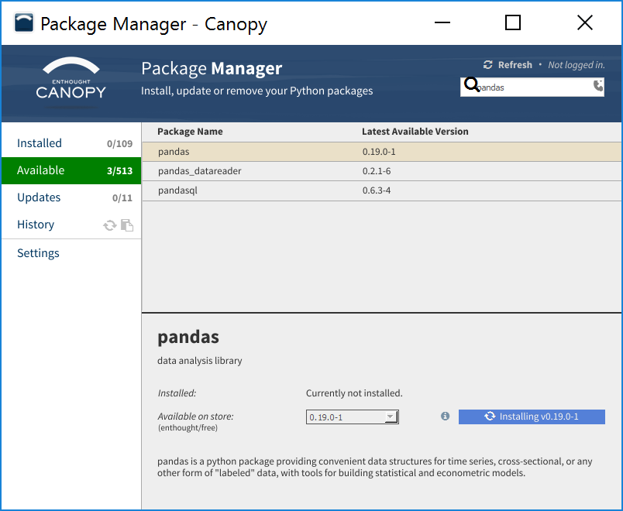
3) Select pandas and install

Slide 24
Programming environment used in this course
After installing Canopy, we have access to:
IPython: an interactive programming environment
Excellent to practice
Jupyter (aka IPython notebook): a web-based interactive environment
Excellent to package your projects
For the HWs and project you will be asked to submit a jupyter file

Slide 25
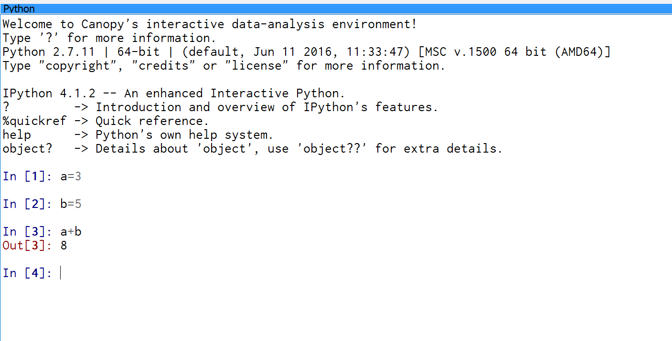
IPython

Slide 26
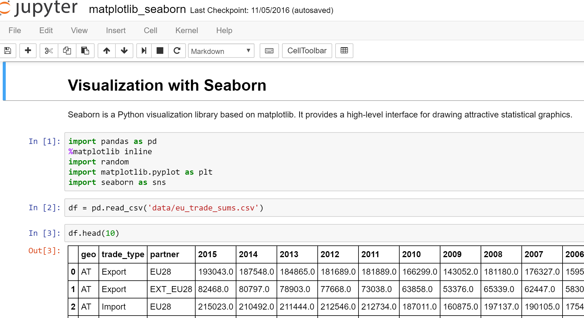
Jupyter

Slide 27
The Jupyter Notebook
Module 1 -- markdown examples on Jupyter.ipynb

Slide 28
The Jupyter Notebook
An environment to incorporate code, formatted (html) text, charts, and other images
Each cell can contain code or text (called markdown)
Each cell can be executed with SHIFT+ENTER or CTRL+ENTER
Executing a code cell prints the result
Executing a markdown cell formats it and displays it
Two modes:
Command mode
Edit mode

Slide 29
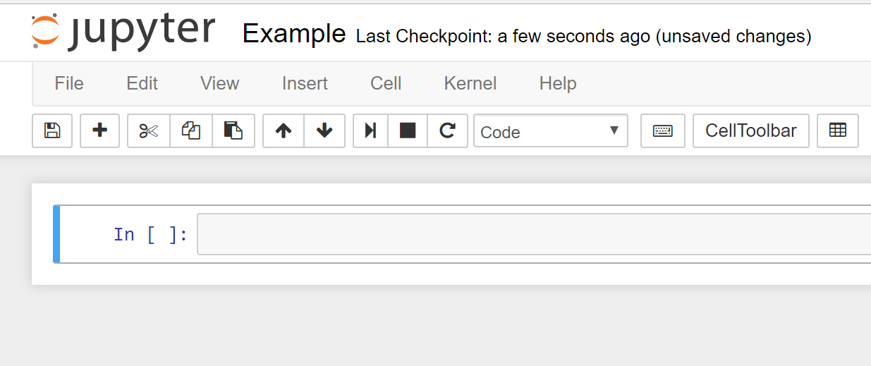
Command mode

Slide 30
Command mode
Shortcut | What it does
a | Insert a cell above
b | Insert a cell below
Enter | Switches to edit mode inside the current cell
m | Changes the cell content to markdown
y | Changes the cell content to code
dd | Deletes the current cell
x,c,v | Cut, copy, paste a cell

Slide 31
Edit mode
Press ESC to switch to command mode
Tags | What it does
<b></b> | Bold
<i></i> | italic
<ol></ol> | Ordered list
<ul></ul> | Unordered list
<li></li> | List item
# | Header of level 1 (main header)
## | Header of level 2
… | …

Slide 32
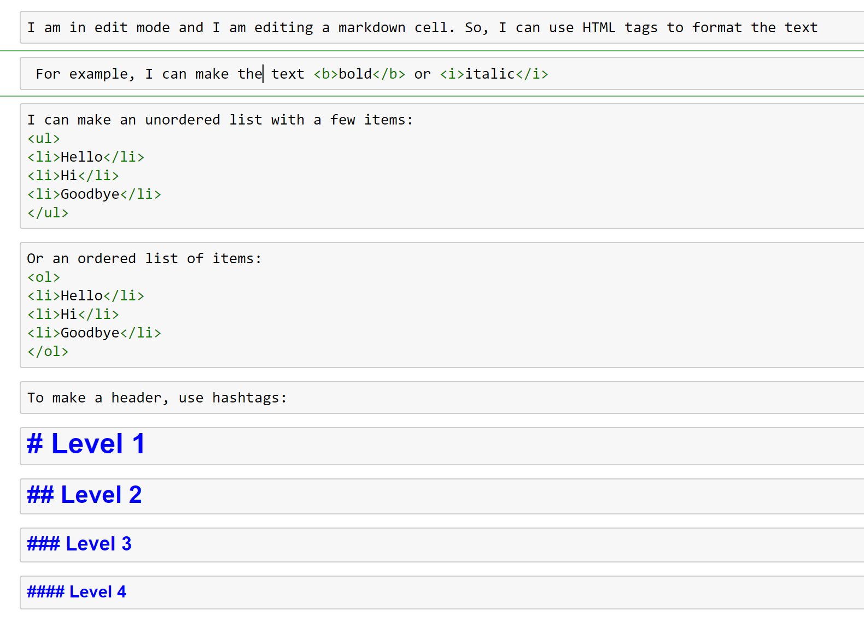

Slide 33
Cheat sheet
https://www.cheatography.com/weidadeyue/cheat-sheets/jupyter-notebook/

Slide 34
Python Review
Open module 1 -- python review.ipynb

Slide 35
In a nutshell
High-level programming language
Interpreted
Dynamically typed
Philosophy: code should be minimal

Slide 36
Continue on module 1 -- python review.ipynb

